Slide 1
Property Listings Management System (Group 16)
Yashaswi Bhavaraju (002743757)
Anamika Verma (002776077)
Sahas Salguti (002194162)
Gaurav Dalvi (002701424)

Slide 2
Objective
The Property Listings Management System is a centralized platform designed to connect genuine landlords/brokers with students seeking off-campus housing.
A comprehensive solution that includes features for managing tenants, rent payments, lease agreements, and amenity details. Students can conveniently access apartment listings from anywhere, and the system allows for filtering based on student requirements.
Accommodates multiple students renting a single apartment and extends its services to non-student users. Overall, the system aims to simplify the process of finding and managing off-campus housing for students, offering a reliable and convenient platform for landlords/brokers and students alike.

Slide 3
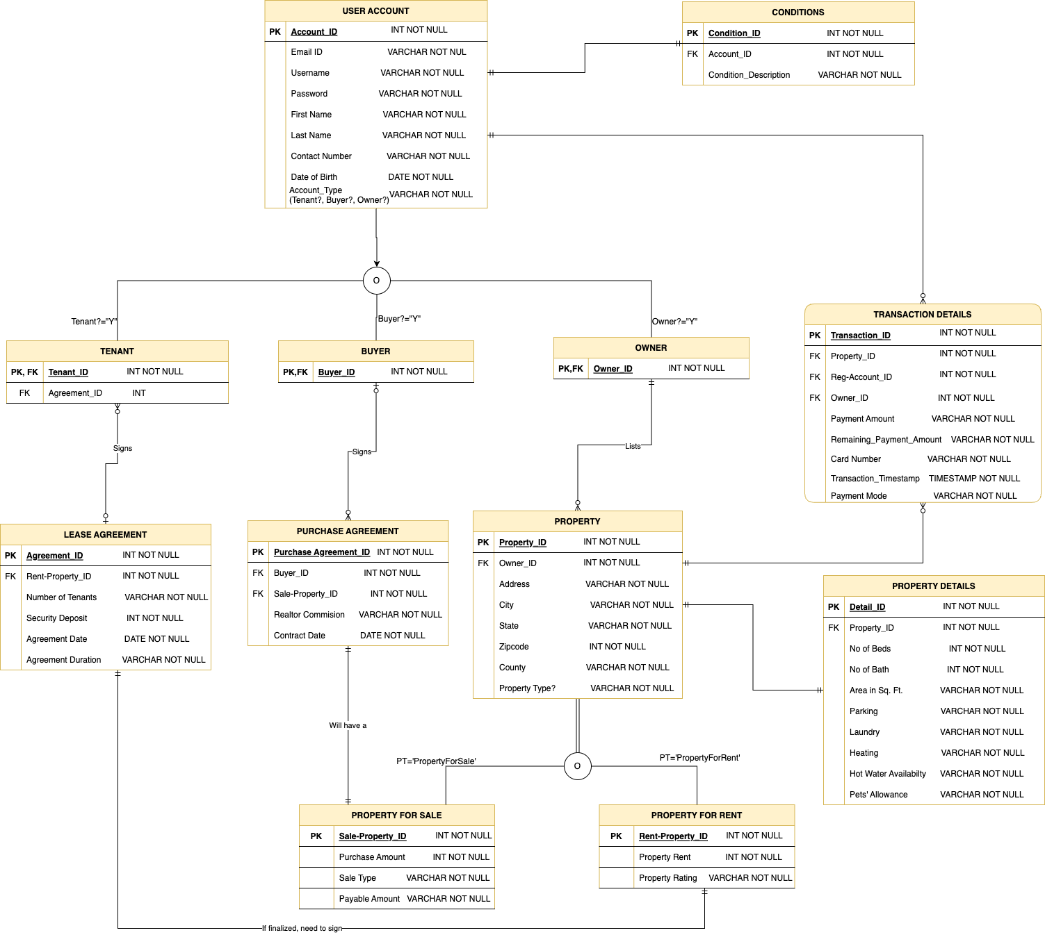
Entity-Relationship Diagram

Slide 4
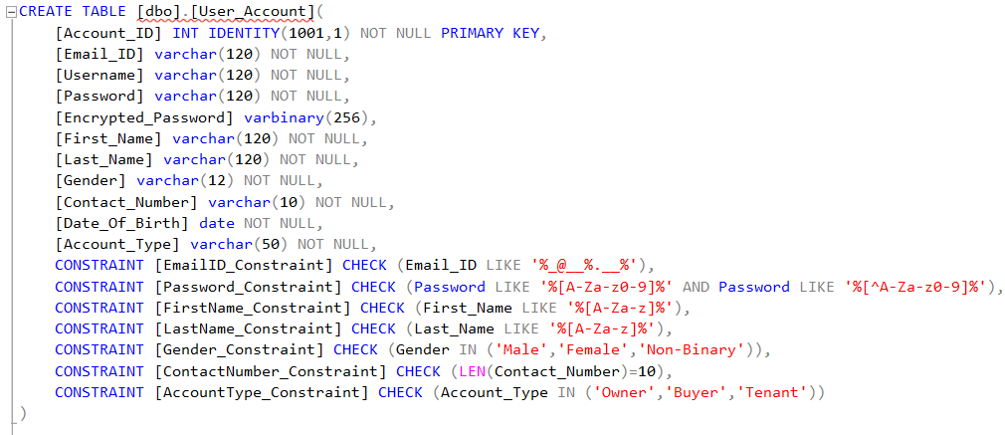
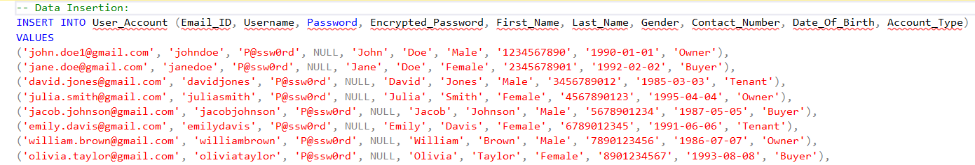
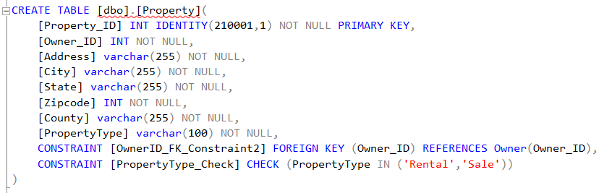
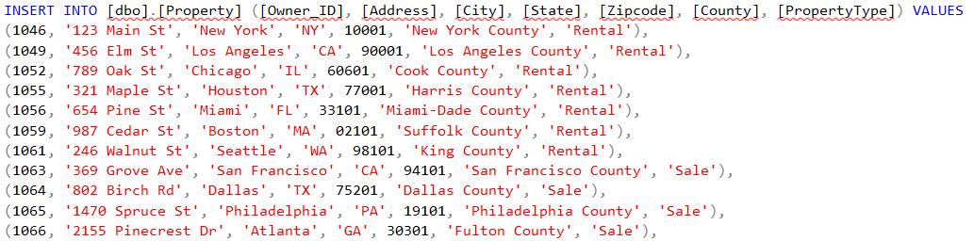
Sample Creation and Insertion

Slide 5
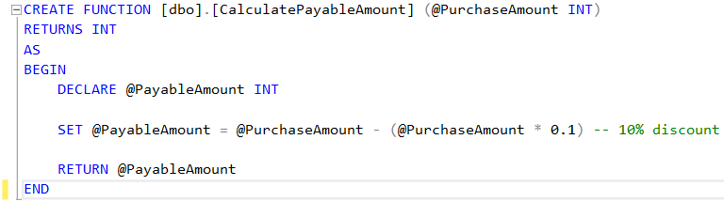
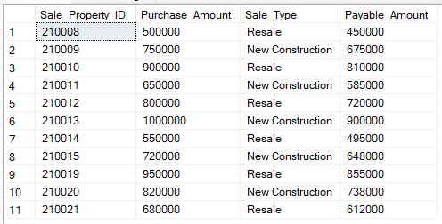
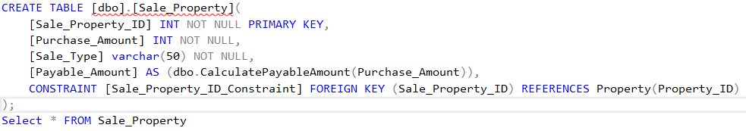
User-Defined Functions

Slide 6
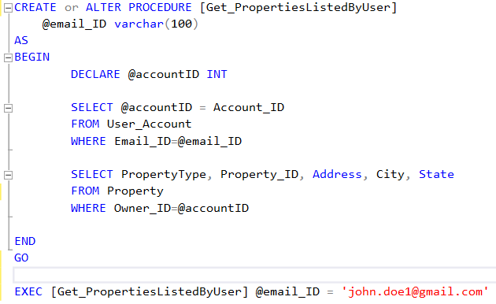
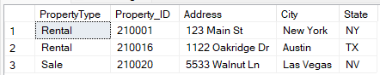
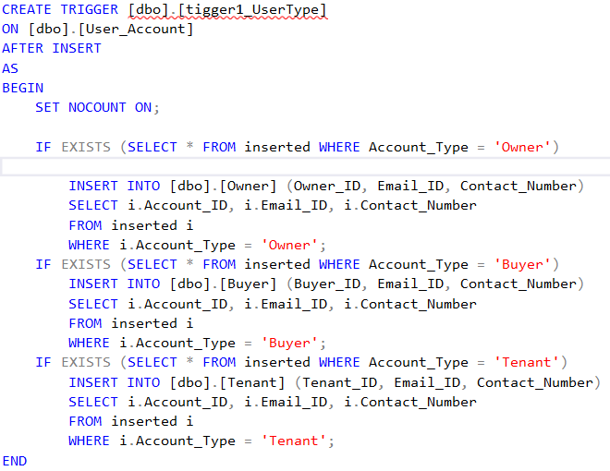
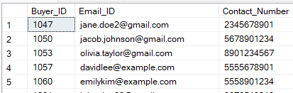
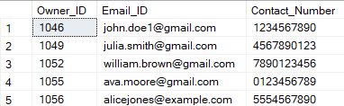
STORED PROCEDURES & TRIGGERS

Slide 7
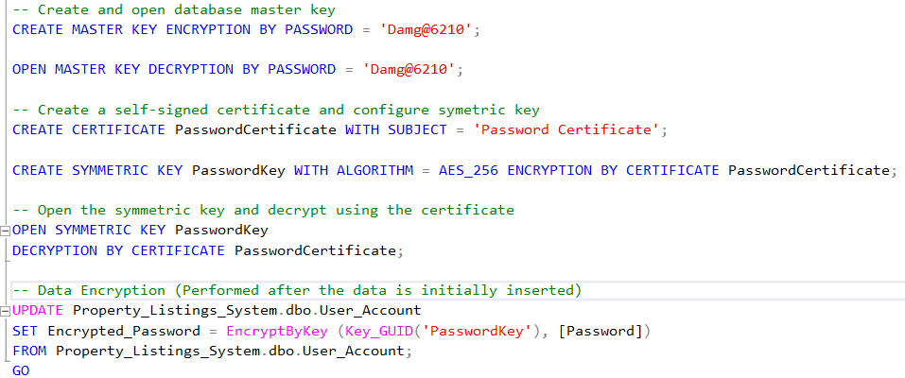
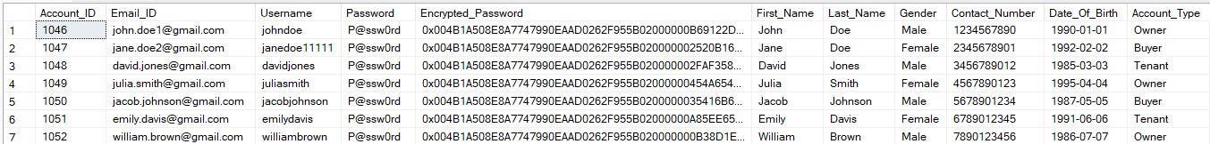
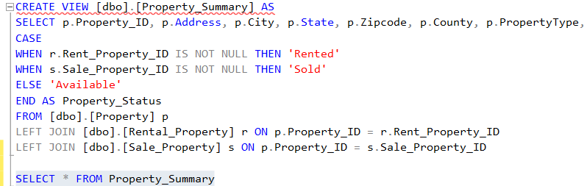
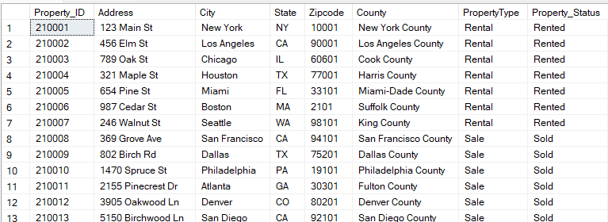
DATA ENCRYPTION & VIEWS

Slide 8
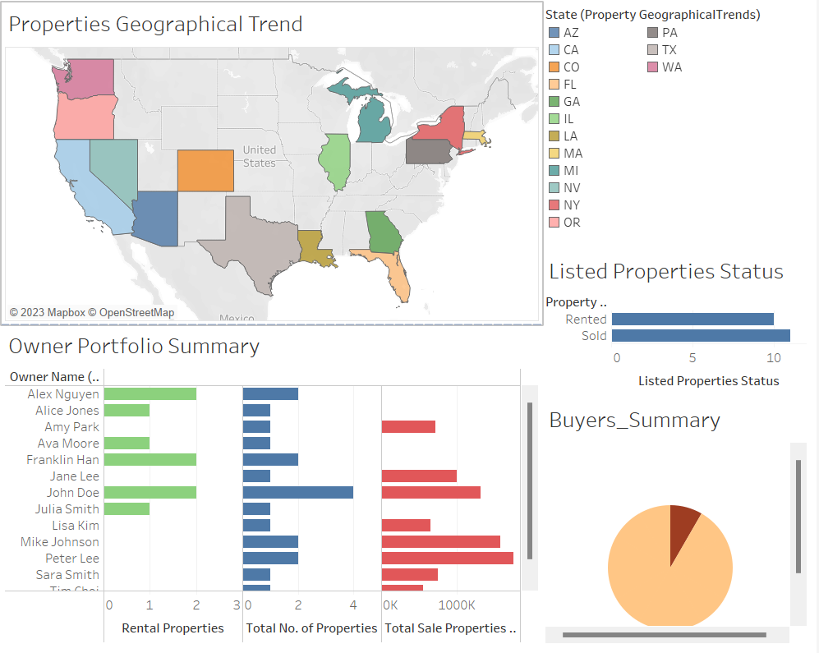
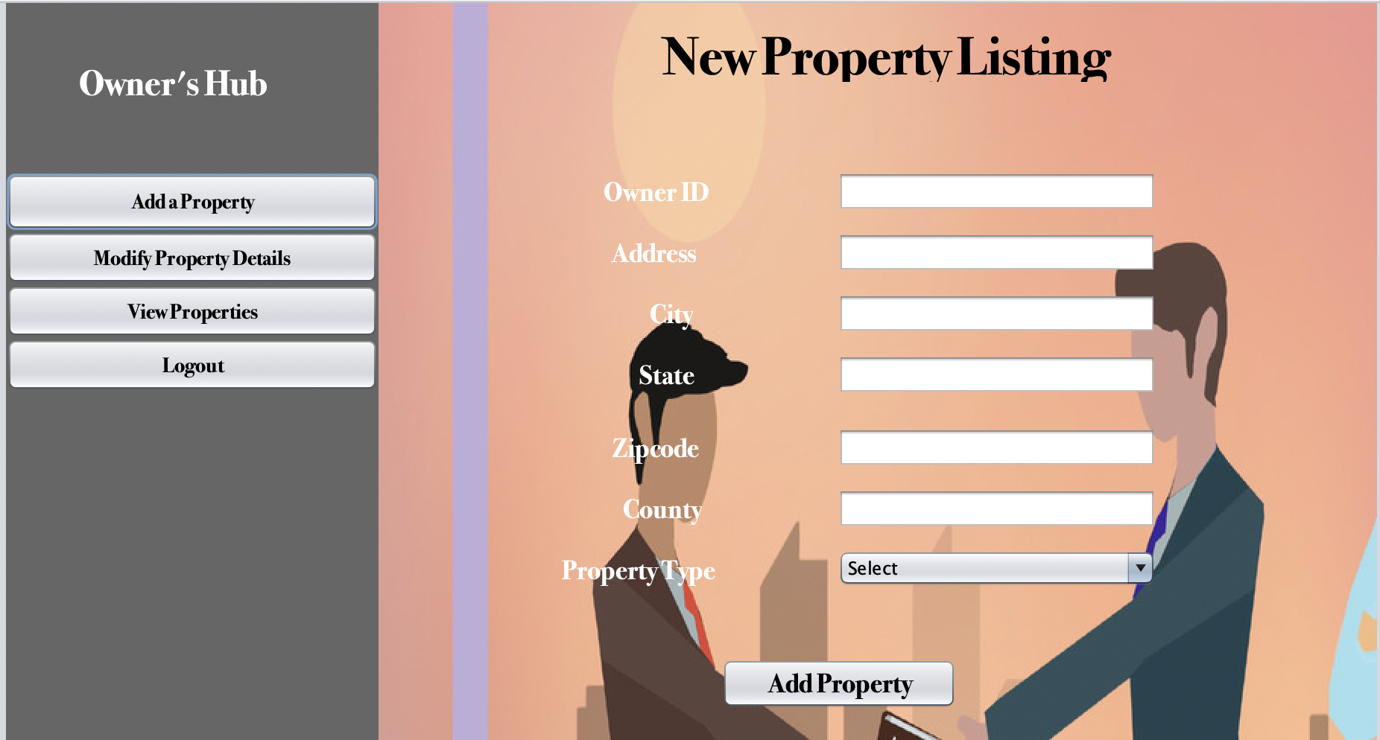
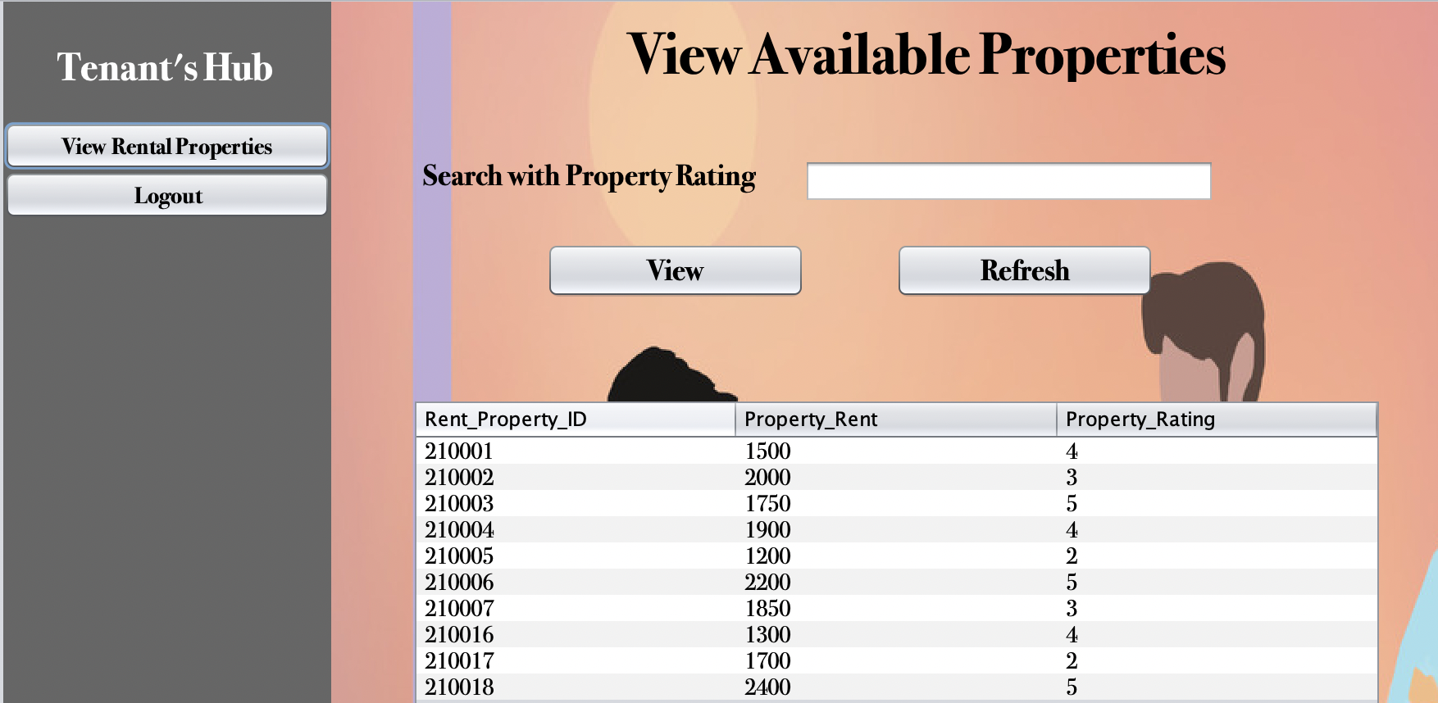
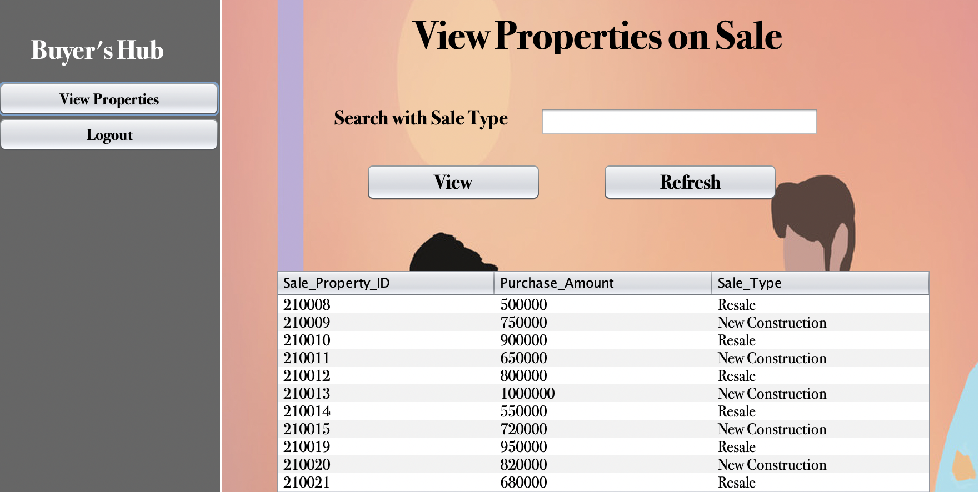
VISUALISATION & GUI

